Slide 1

EUROPEAN UNIVERSITY OF LEFKE
FACULTY OF ENGINEERING
Graduation Project 2
School Bus Tracking and Information Website
Andile Nleya
164611
Supervisor: Prof. Zafer Erenel
June 2021

Slide 2
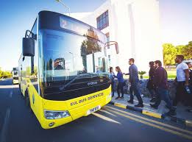
Introduction:
Students use the bus everyday during the term
The bus can be late or canceled due to various reasons
Students can miss exams or be late for their classes
I decided to make an informative website that included a gps tracking system

Slide 3

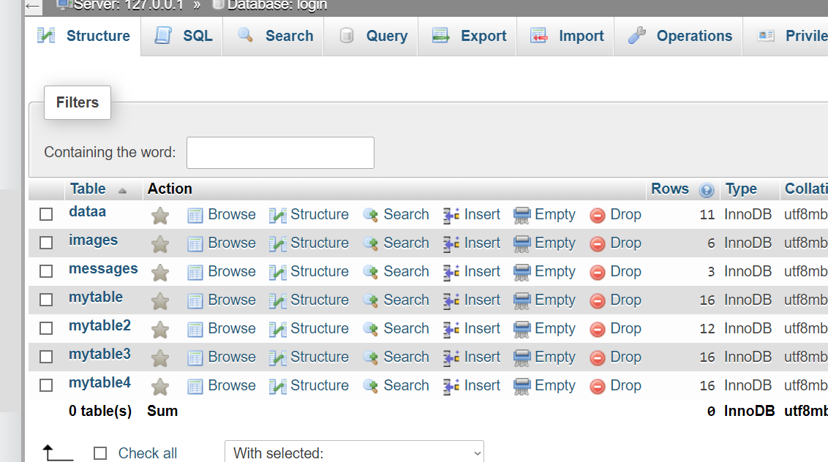
XAMPP
- A free and open-source web server
Stands for Cross-Platform, Apache, MySql, PHP, Perl
Xampp allows you to build a website on your local server
Database:
To open MySql, a database management system, I opened Xampp control panel
Clicked on php admin.
I created a database using SQL
I created tables with information for my website

Slide 4
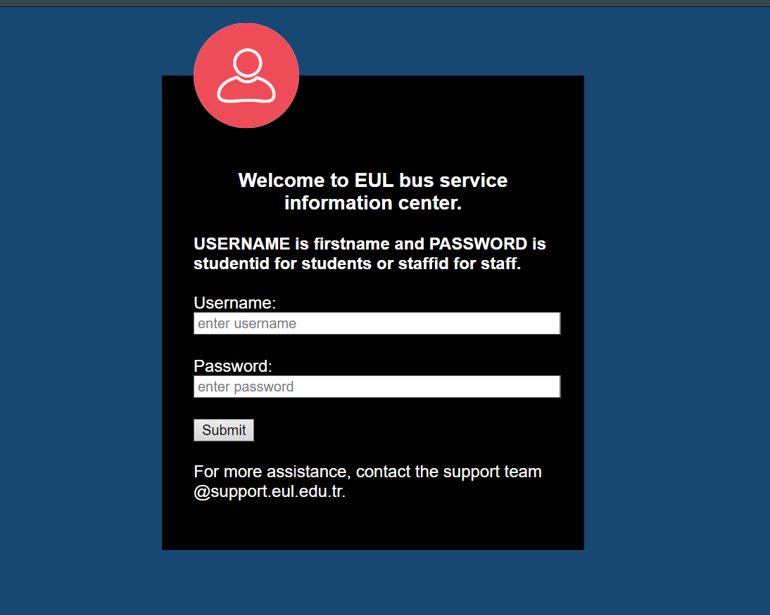
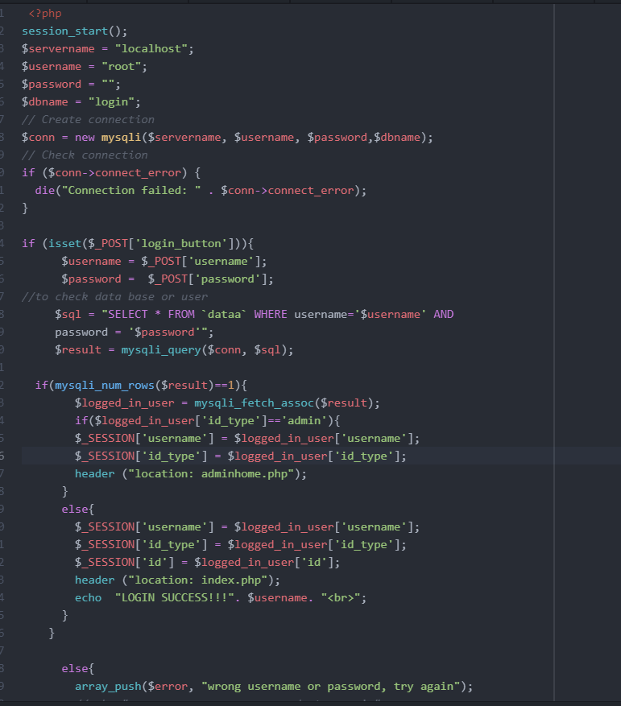
Login Page
This is the welcome page. It has a login form
First I connected to the database,then I check if the credentials entered by user are in the data.
On success, user is redirected to our home page, where they have access to Information about the bus, The timetable, gps tracker and also contacting the admin.
Admin redirected to Admin dashboard.

Slide 5
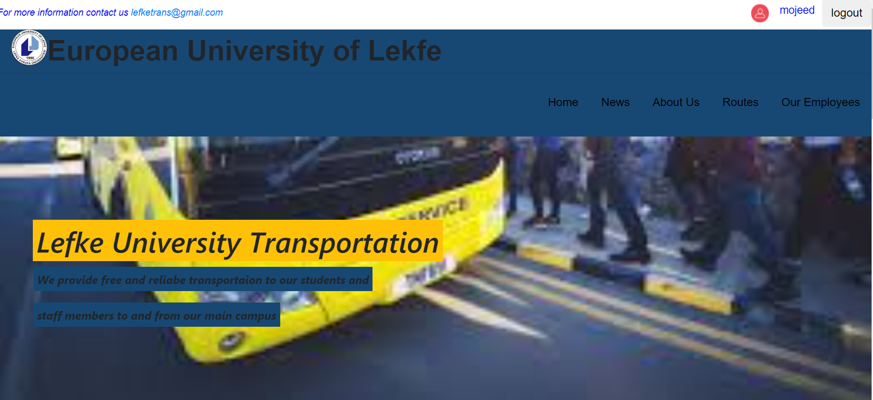
Home page
On the top right of the page, the username of the logged in user is displayed using php echo
Next to it is a logout button for when the user is done browsing
Our menu has links to other pages in our website
The rest of the home page has general information

Slide 6
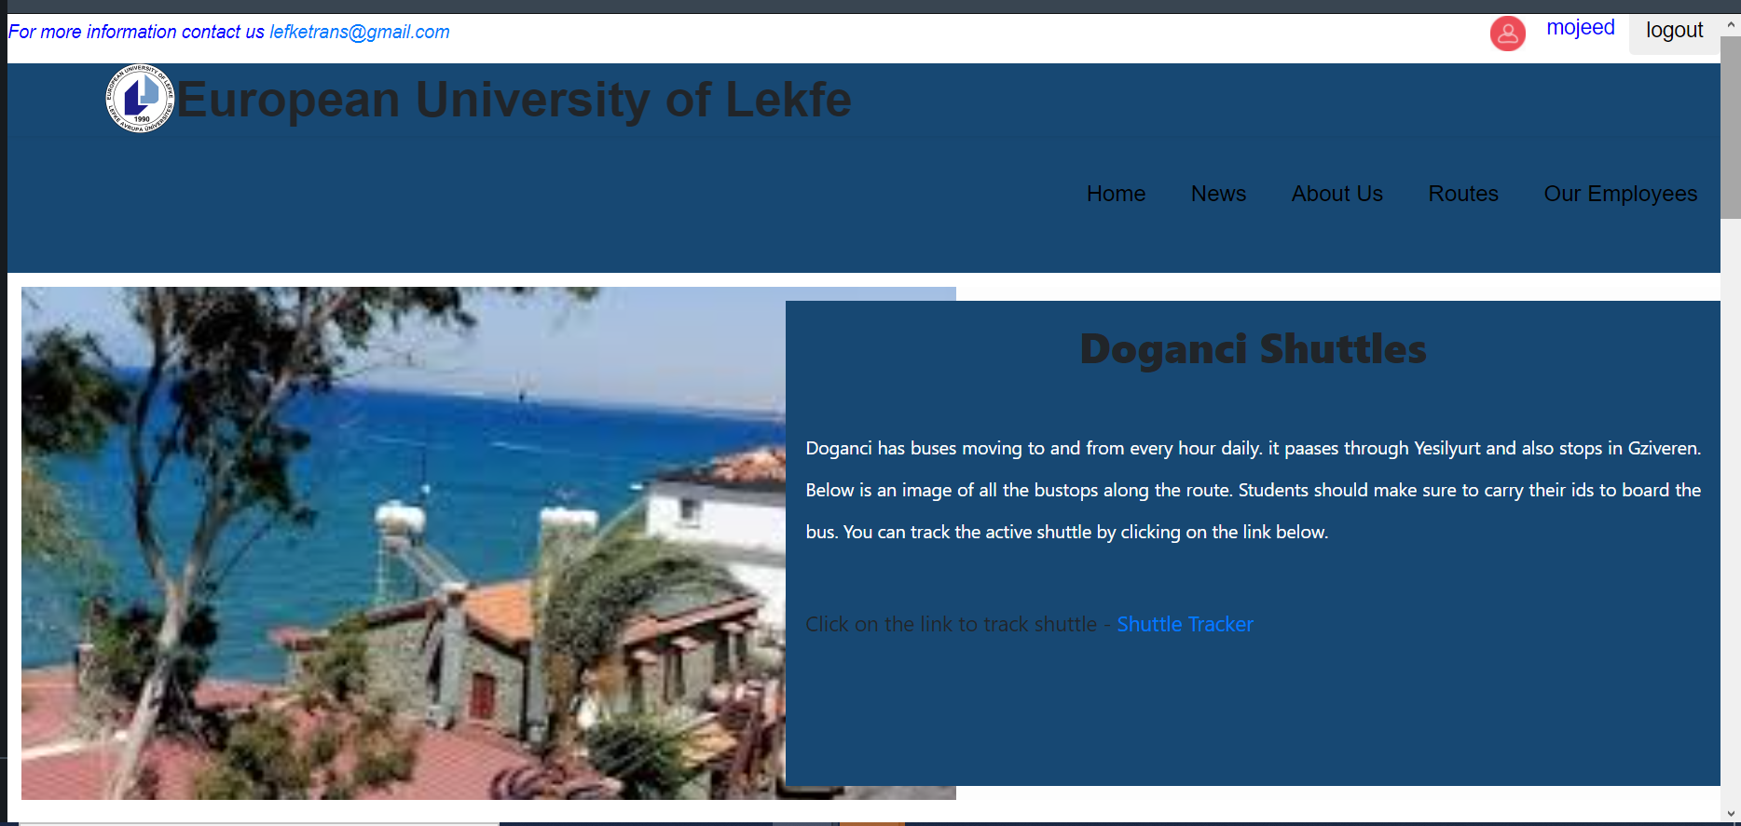
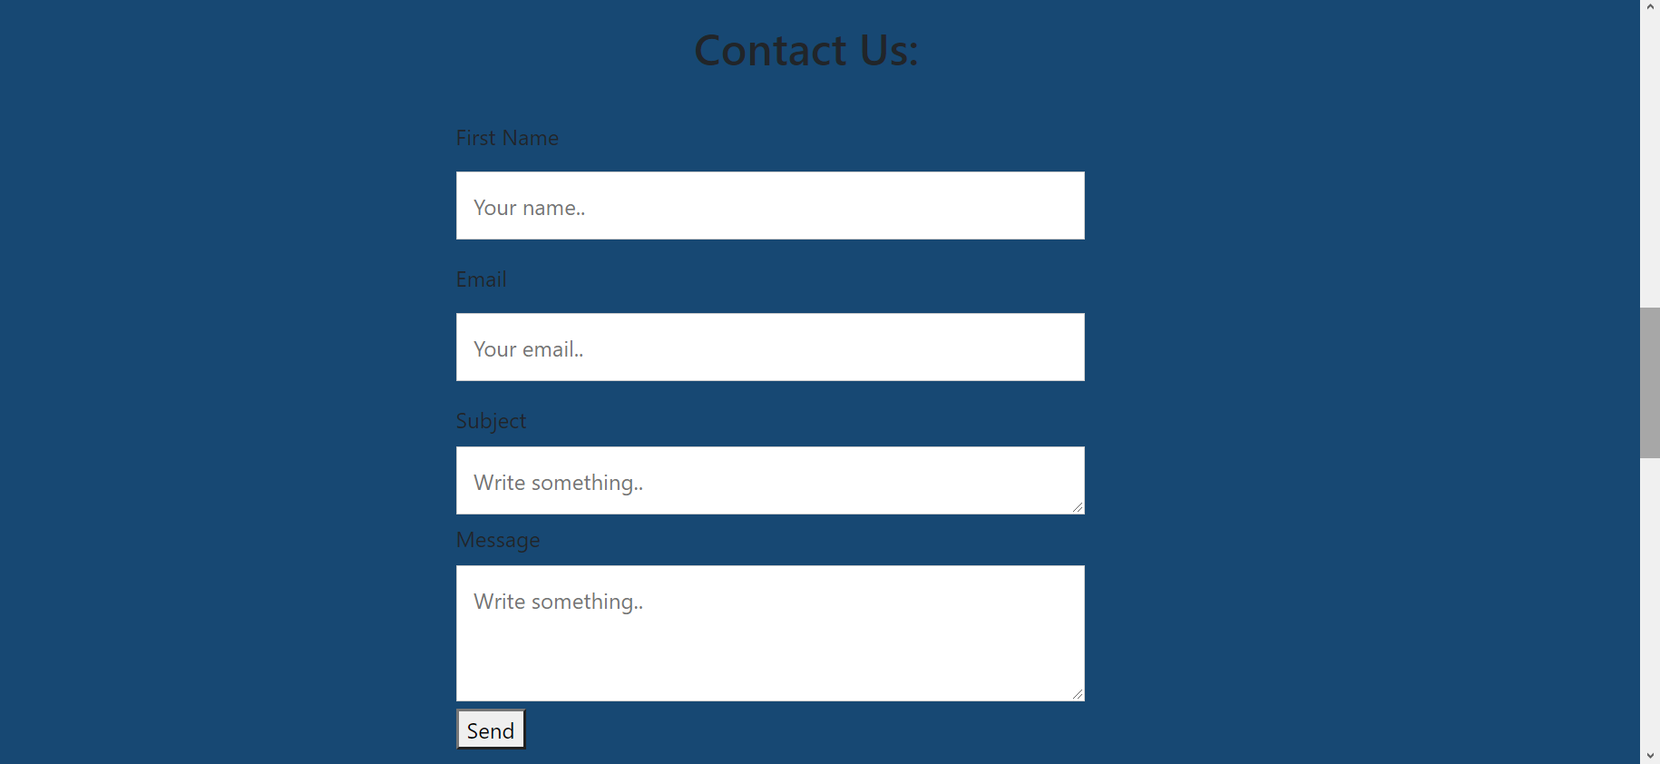
Route Page
Aboutus Page
Each route the bus takes has its own page
This is the Doganci page, with information about the Doganci buses
There is a link to track the bus
You can also find the bus schedule on displayed from the database
This is a contact form found on the About us page.
Students can use it to contact the admin.
I used phpmailer to achieve this.

Slide 7
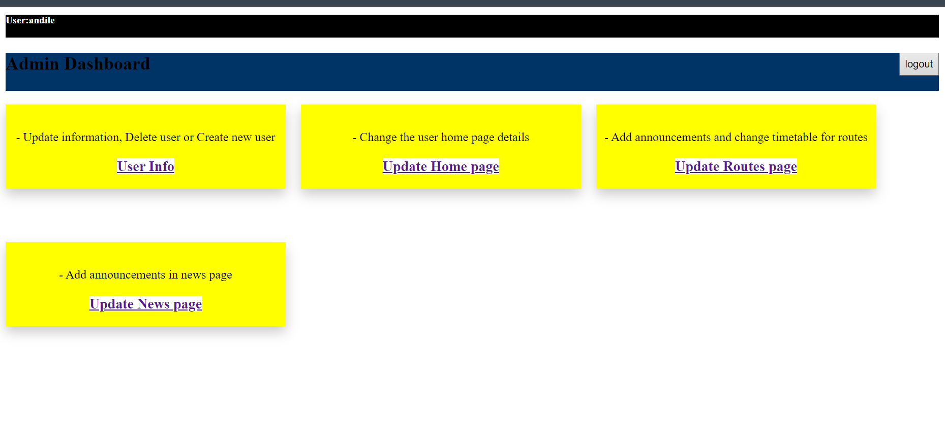
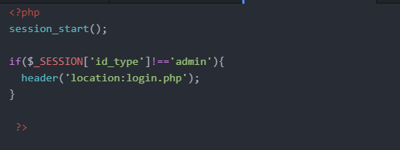
Admin dashboard
When the logged in user is an admin, they are redirected to Admin dashboard instead of Home page.
The admin is able to manage the user database and some content on the user webpages like up updating news and changing bus timetable.
The admin pages are only accessible to the admin and the php code above makes sure of that.

Slide 8
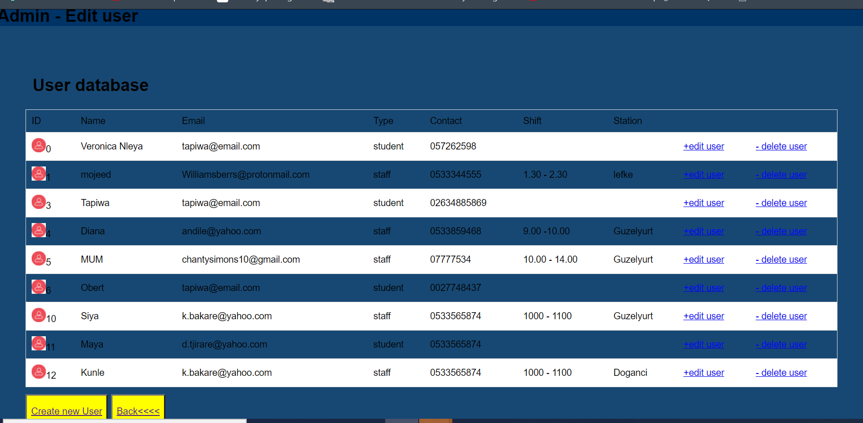
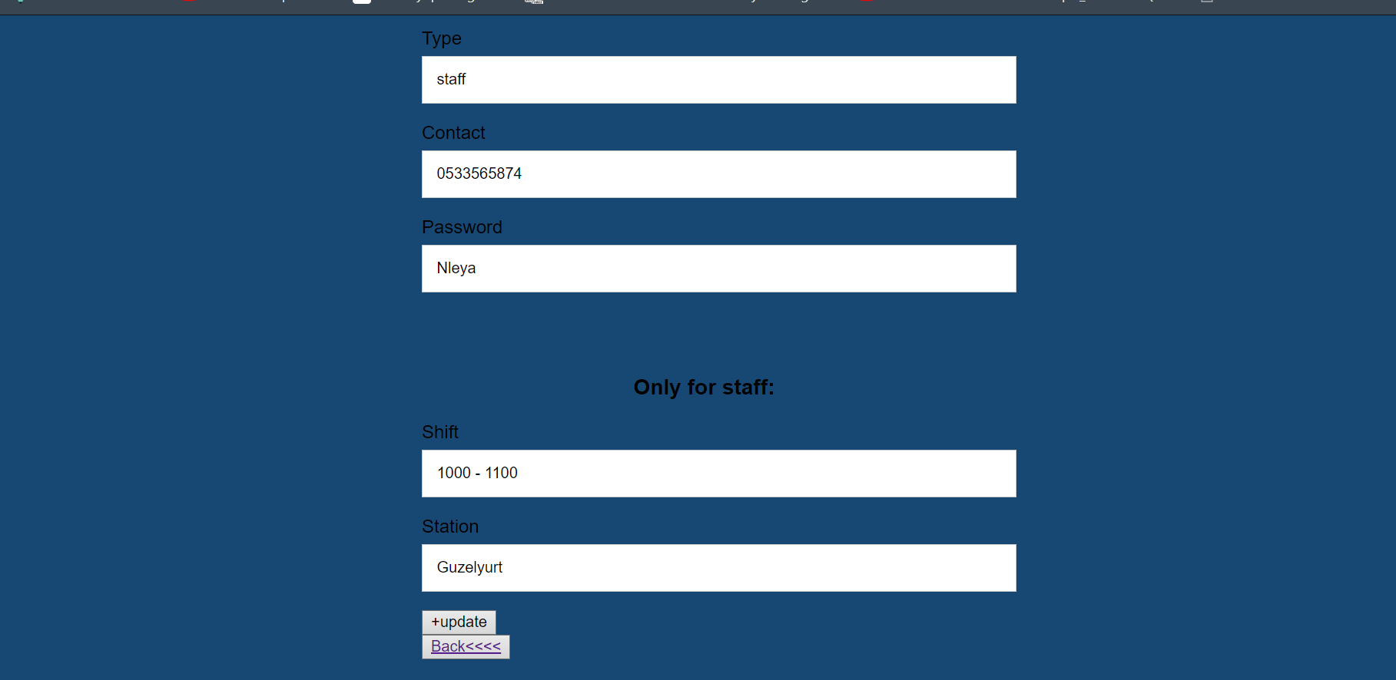

User Info
When admin click on User Info in the dashboard they are redirected to a page with a list of all the user and options to edit user, delete user or create new user.
If they select edit user, they get a form to edit user info.
On success, the desired updates are saved in the database and an alert to noticy the admin pops up
There are other options for admin like edit timetable and update news.

Slide 9
GPS System To archieve the gps tracking system, I used following: 1. Hardware - Esp32 development board - Gps neo-6m module - Breadboard - Connecting wires 2. Thingspeak 3. Arduino IDE - Esp32 expressif - Esp32 software serial - Wifi library - Tinygps++ library - Thingspeak library

Slide 10
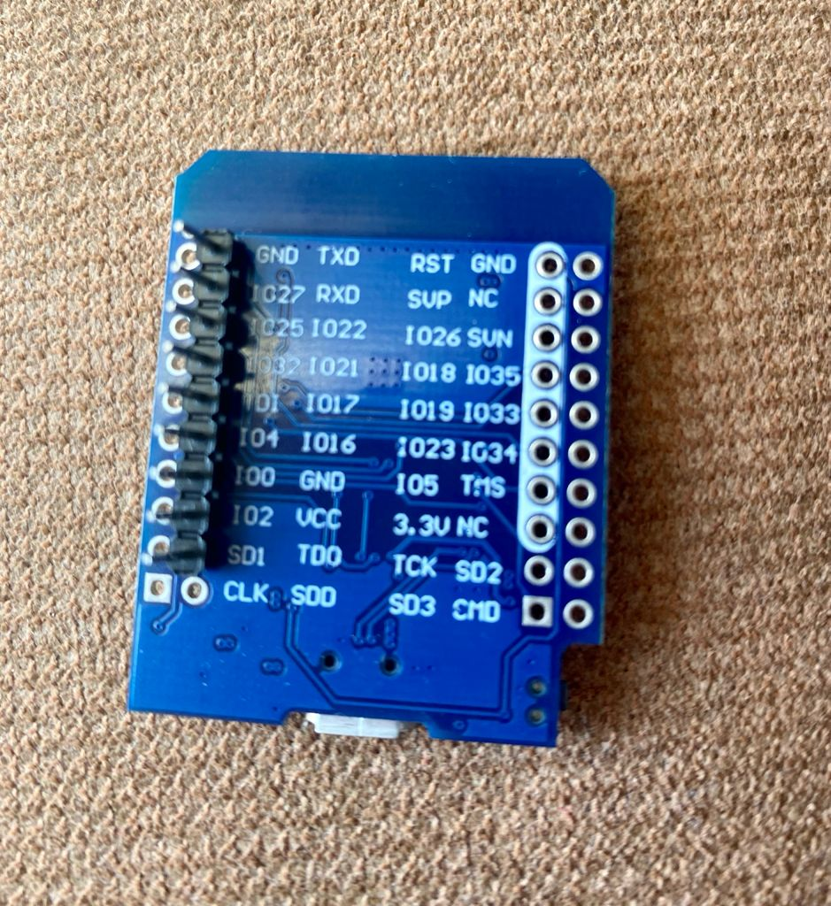
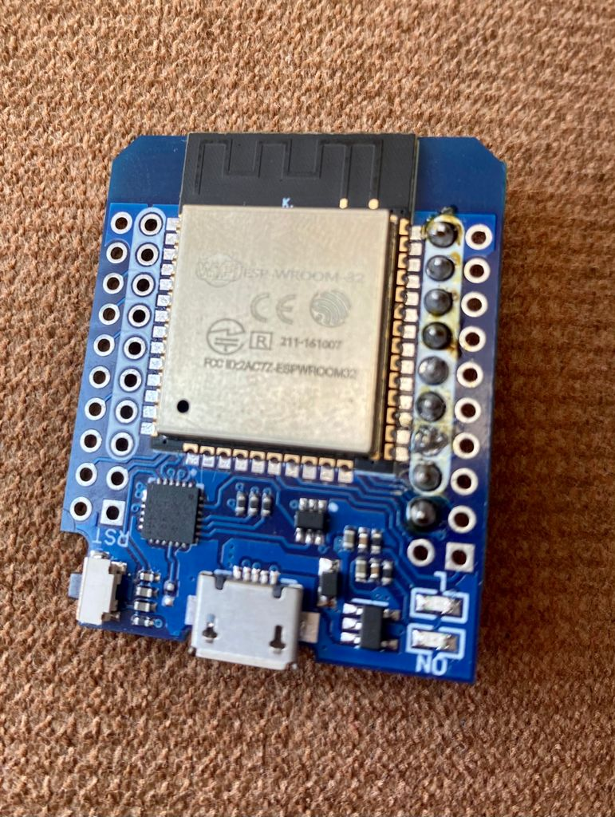
Esp32 development board
This is a microcontroller
It has intergrated Bluetooth and WiFi
Esp32 can act as a slave with another microcontroller or a master to another device.
It uses USB connection for power.
Esp32 board has to be downloaded from ExpressIf to the Arduino IDE
I also downloaded the ESP32 Softwareserial library to use the UART for communication.

Slide 11
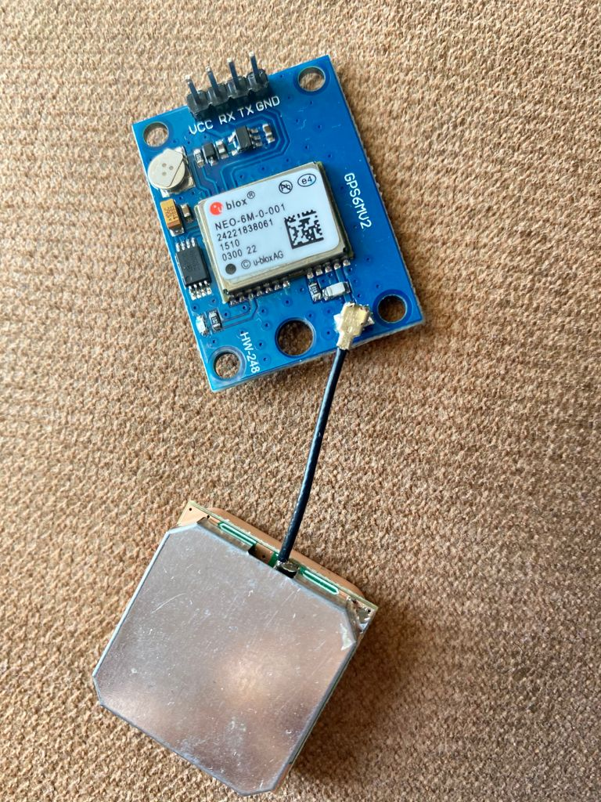
GPS neo – 6m module
This is a global positioning system.
It has a stand alone gps receive to get latitude and longitude coordinates of the nearest satellites
The gps has TX pin to send data and RX pin to receive data.
It communicates using UART
I downloaded Tinygps++ library to be able to manipulate the information from the gps.

Slide 12
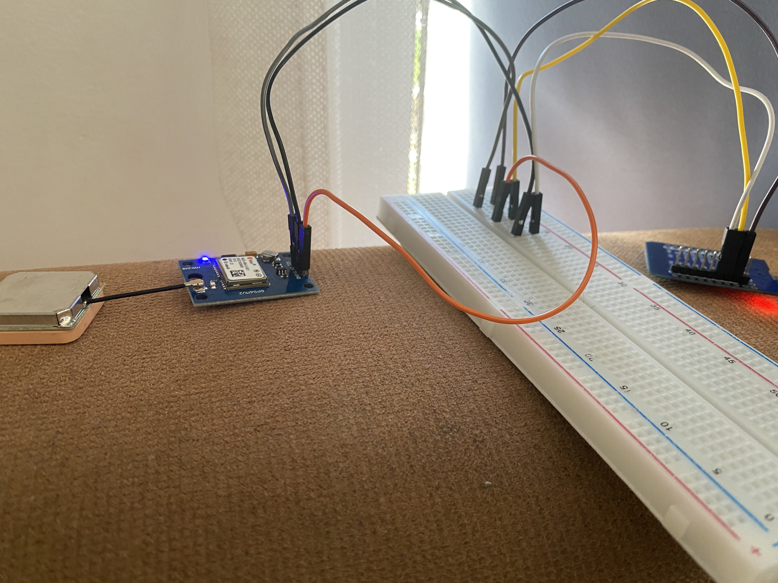
The connection
First I connected the Esp32 to my laptop and opened the Arduino IDE.
I selected the esp32 board from the tools menu and also connected at port COM4.
Before connecting the gps module, I uploaded the programming code(next slide).
I connected the gps module after the code was uploaded.
GPS | ESP32
Vcc | Vcc
Ground | Ground
TX | 16 (defined as RX)
RX | 17 (defined as TX)

Slide 13
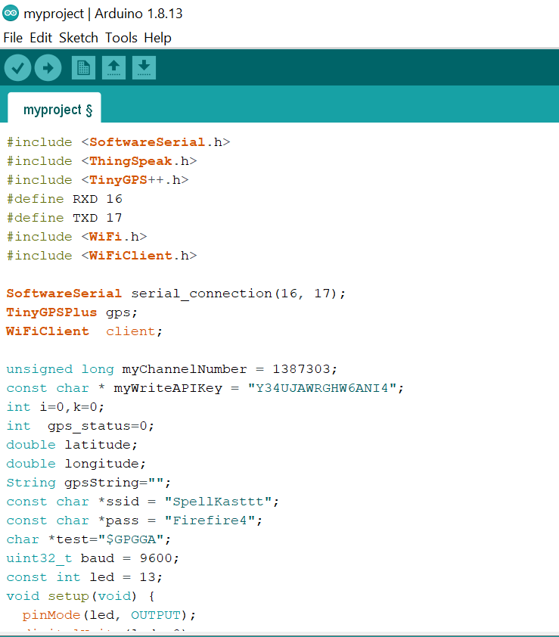
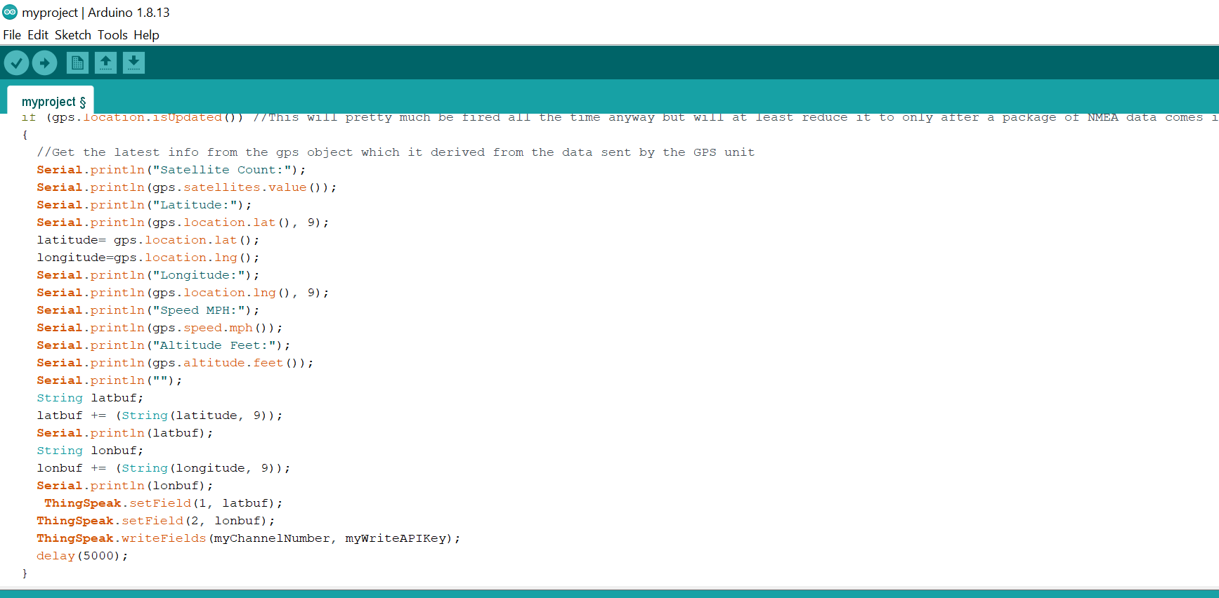
The Arduino IDE code
First I defined the necessary libraries
I Defined the pins 16 to receive and 17 to send, then started a serial connection.
Then I initialized a tiny gps object, wificlient object and other necessary variables.
Esp32 connects to the wifi using credentials provided.
When serial begins, tiny gps object receives coordinates from gps and encodes then passes the latitude and longitude to two variable.
Thingspeak receives the coordinates and using channel number and writeapi, saves them to my thingspeak project.

Slide 14
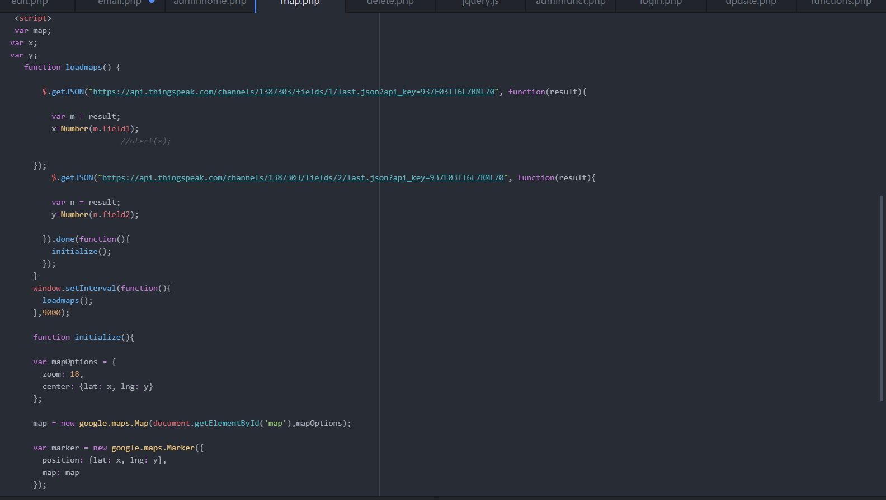

On the routes page , the user will click on the shuttle tracker link and be redirected to the php file below.
The Javascript code
I used getjson function to get the gps coordinates from thingspeak channel number and readapi.
I saved the latitude and longitude to variables.
I created and a google map and passed the variable as latitude and longitude.
Then I displayed it on an html div box using getelementbyid

Slide 15
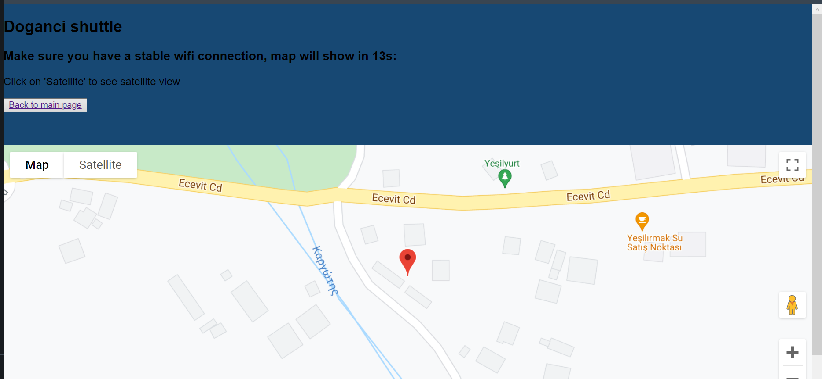
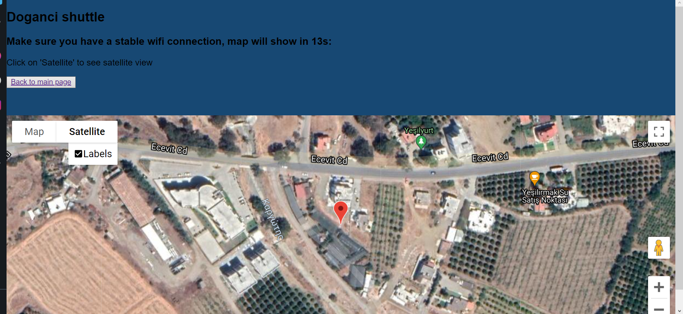
Map view Satellite view
-This will be the map displayed to the user showing the live location of the school bus.
- This project is important as it will directly impact the quality of life for the students. In the future I would like to improve it by adding a seat counter to notify the driver and students when a bus is full.
- Thank you.

